Slide 1
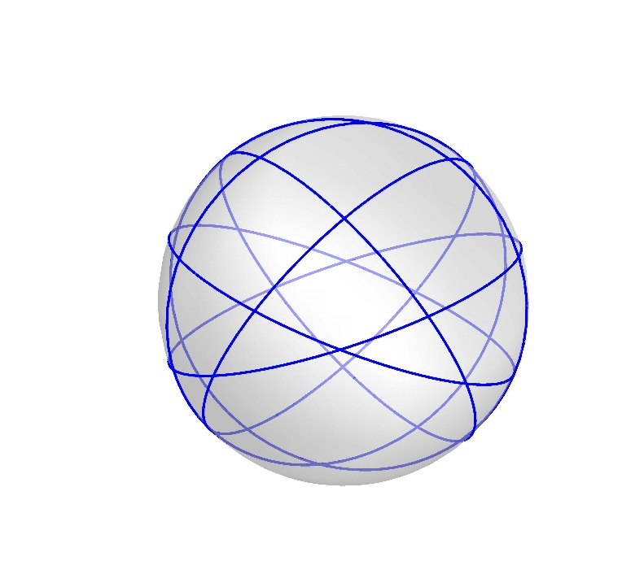
Great Circles Problem
Kha Man
1-25-2015

Slide 2
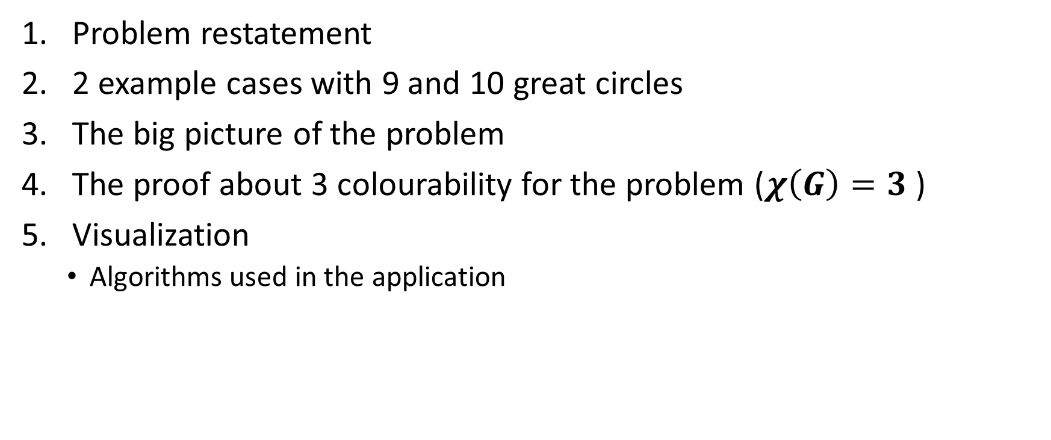
Outline
Problem restatement
2 example cases with 9 and 10 great circles
The big picture of the problem
The proof about 3 colourability for the problem ($χ\left(G\right)=3$ )
Visualization
Algorithms used in the application

Slide 3
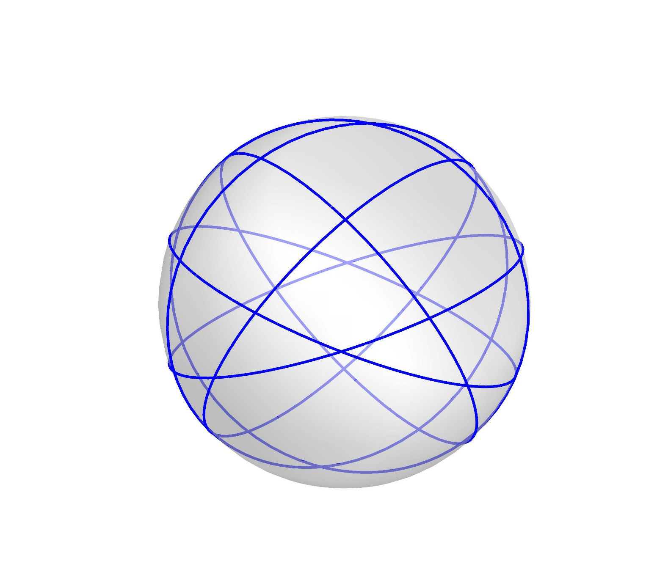
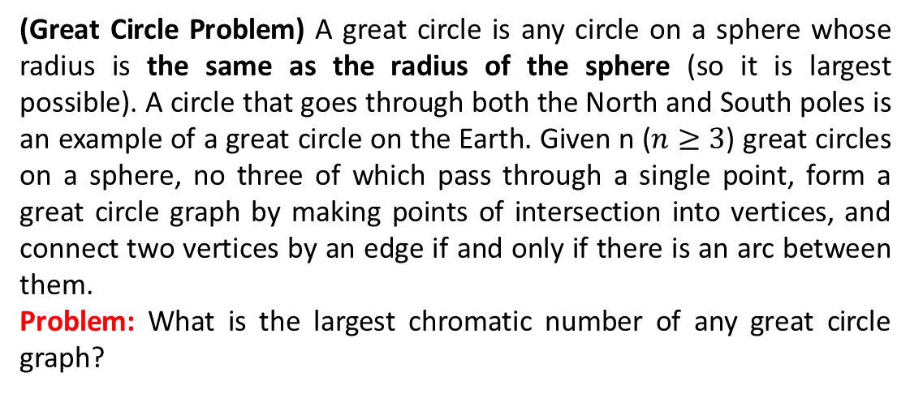
Problem Restatement
(Great Circle Problem) A great circle is any circle on a sphere whose radius is the same as the radius of the sphere (so it is largest possible). A circle that goes through both the North and South poles is an example of a great circle on the Earth. Given n ($n≥3$) great circles on a sphere, no three of which pass through a single point, form a great circle graph by making points of intersection into vertices, and connect two vertices by an edge if and only if there is an arc between them.
Problem: What is the largest chromatic number of any great circle graph?

Slide 4
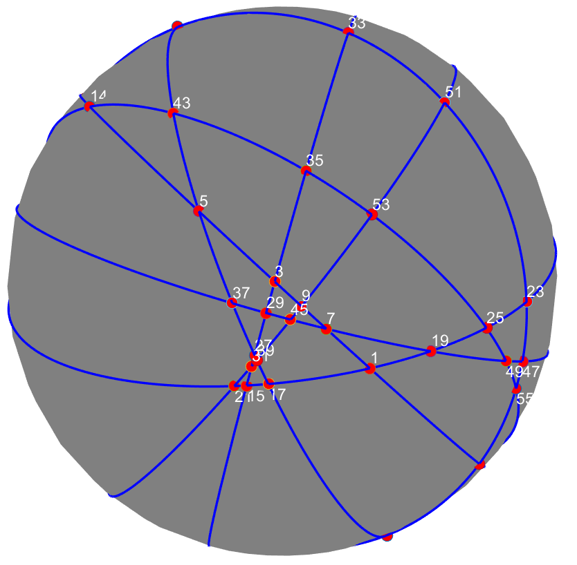
Observation
Great circles problem has been visualized on MATLAB which helps to have an abstract view about the problem. Moreover, I tried to plot out the planar embedding of some graphs.
One significant meaning from the planar embedding graphs plot out is with a specific number of great circles, there exists a way to rearrange vertices (intersections) to form an unique graph. For example, all 5 great circles can have the same planar embedding graph. It means we can reduce the problem into coloring the unique graphs
We can know more about this work in the section 5.

Slide 5
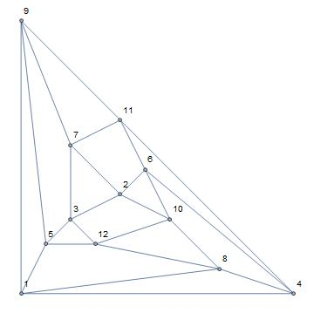
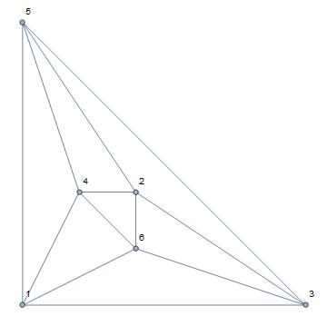
Planar embedding (3,4)
3 great circles
4 great circles

Slide 6
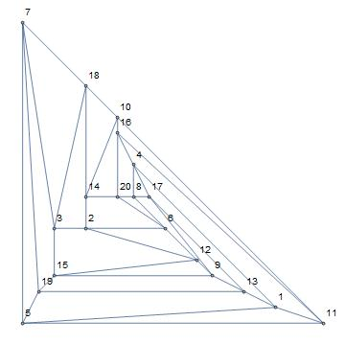
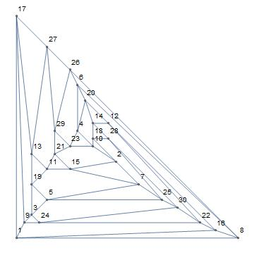
Planar embedding (5,6)
5 great circles
6 great circles

Slide 7
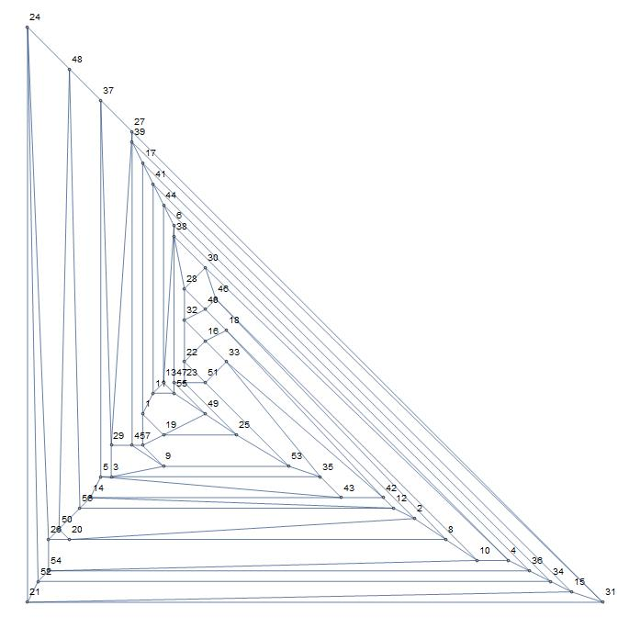
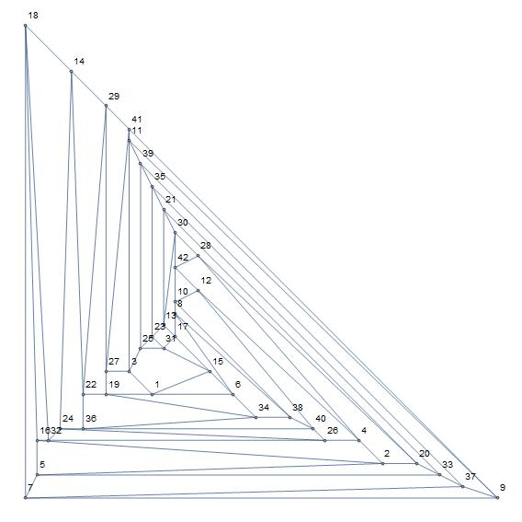
Planar embedding (7,8)
7 great circles
8 great circles

Slide 8
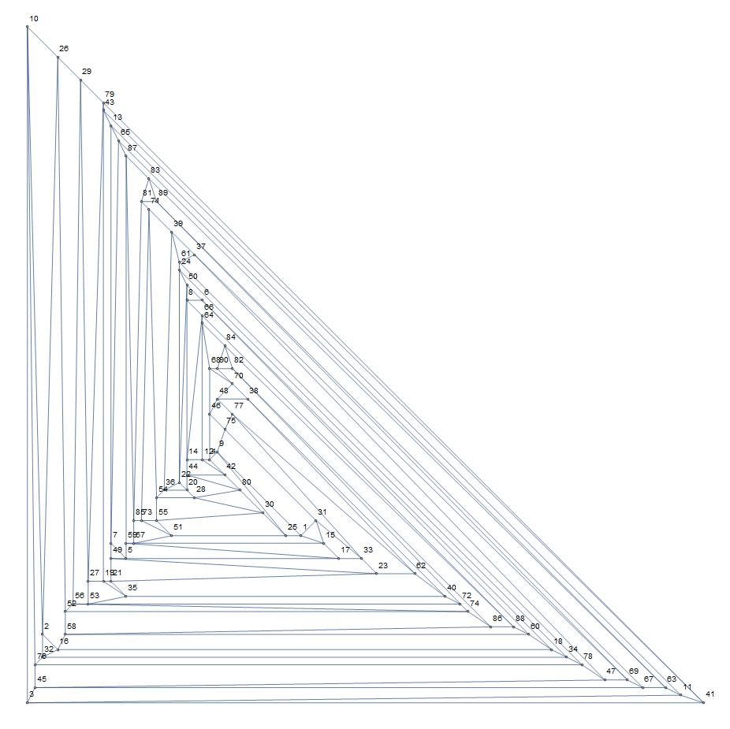
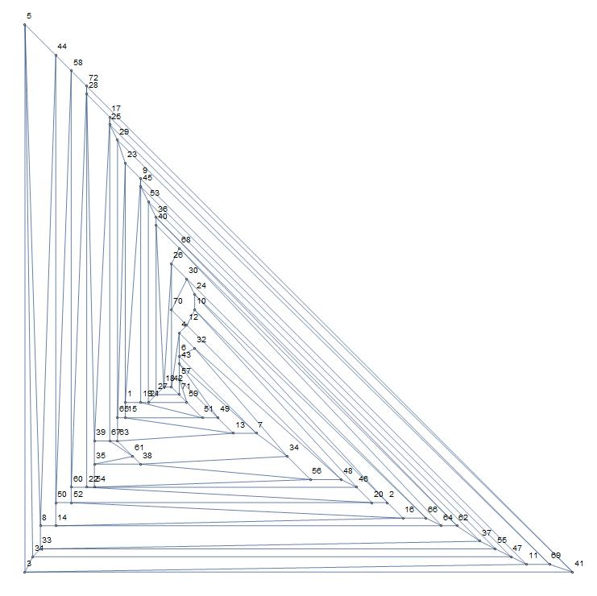
Planar embedding (9,10)
9 great circles
8 great circles

Slide 9
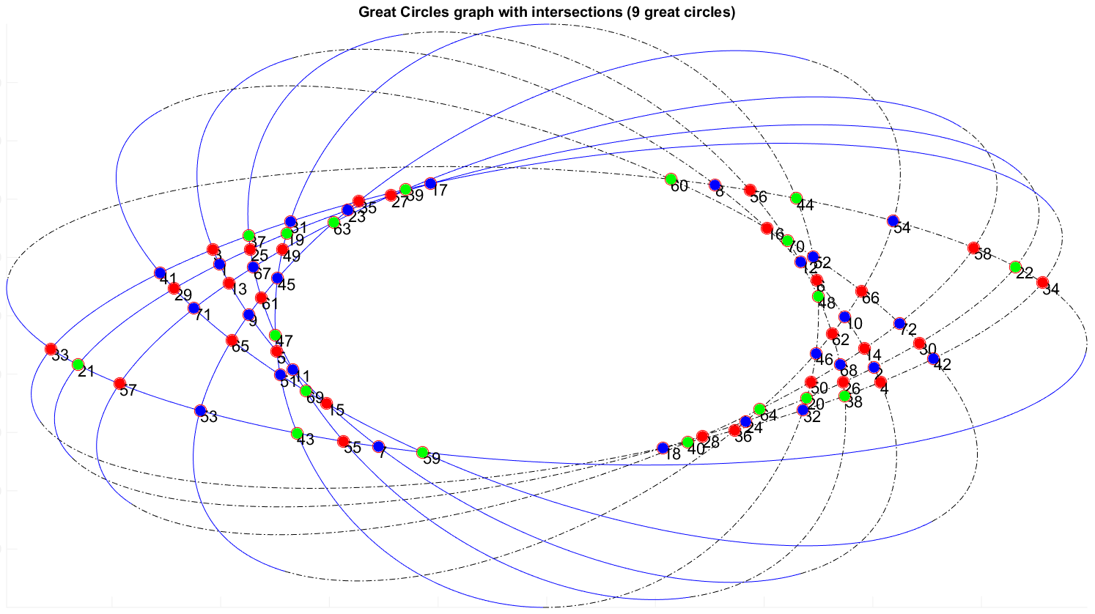
Problem Restatement

Slide 10
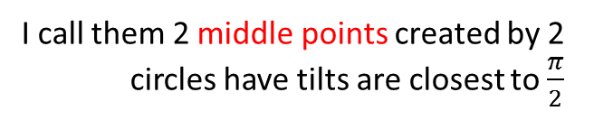
An example case (9 great circles)
I call them 2 middle points created by 2 circles have tilts are closest to $\frac{π}{2}$
. O
The middle line
: Top
----------- : Bot

Slide 11
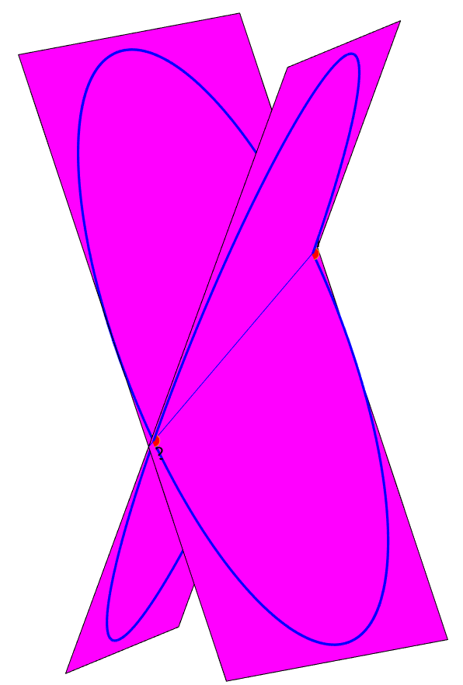
A example case (9 great circles)
Observation:
The center of all circles O is the point symmetry of vertices on both sides of the line connected 2 middle points
Proof:
2 circles in 3D can be considered as 2 circle planes.
The intersection of 2 planes is a line
Obviously all possible intersections of 2 planes are on that line including O since both great circles have the same center
The line intersects a circle at 2 points
Therefore, all the intersections created by pairs of circles and O are on a line.

Slide 12
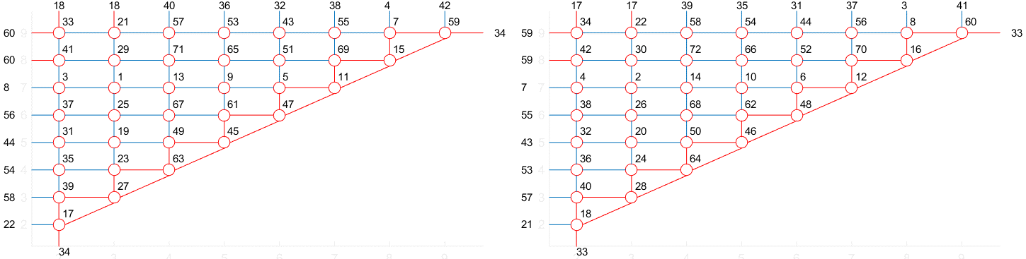
Redraw the graph (9 great circles)
Left side
Right side

Slide 13
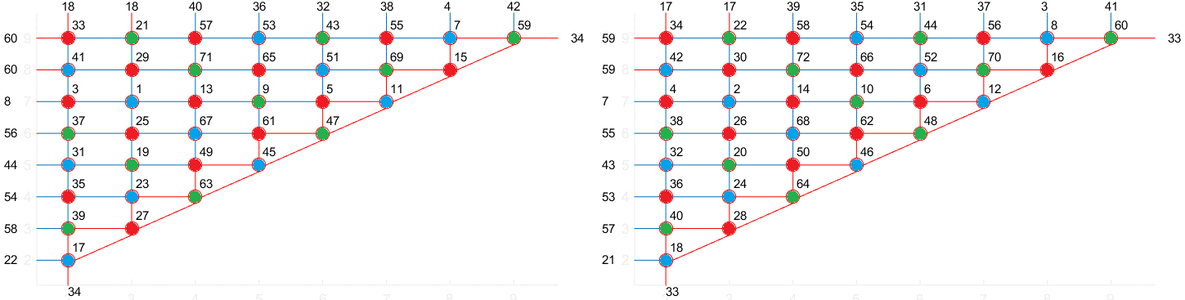
Color the graph
Left side
Right side
Observation: The vertices on the same diagonal usually have the same color

Slide 14
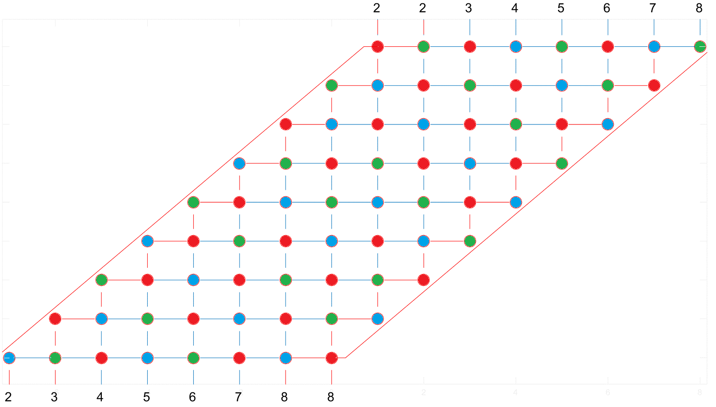
Color the graph
The numbers only show the connection in this graph only

Slide 15
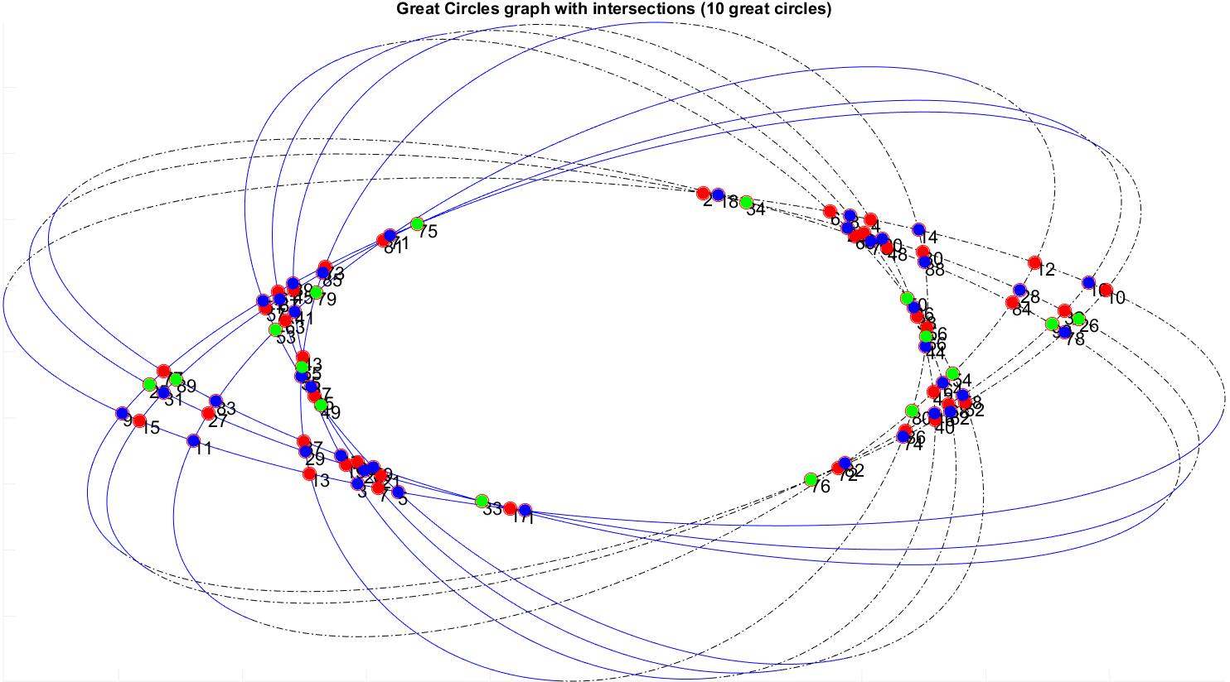
An another example (10 great circles)
. O

Slide 16
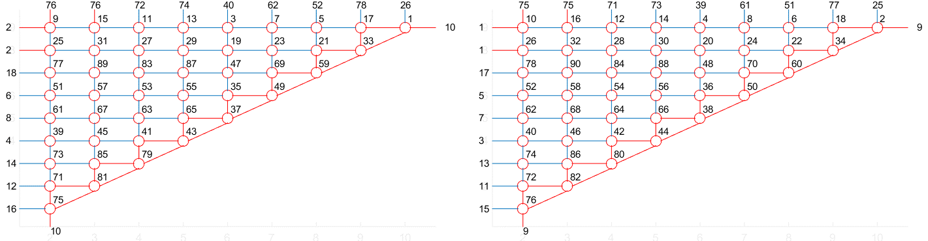
Redraw the graph (10 great circles)
Left side
Right side

Slide 17
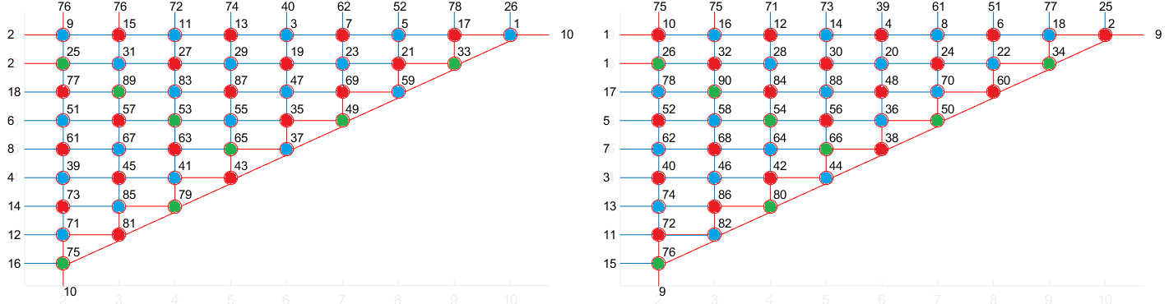
Color the graph (10 great circles)
Left side
Right side
Observation: The vertices on the same diagonal usually have the same color except ones on the hypotenuse

Slide 18
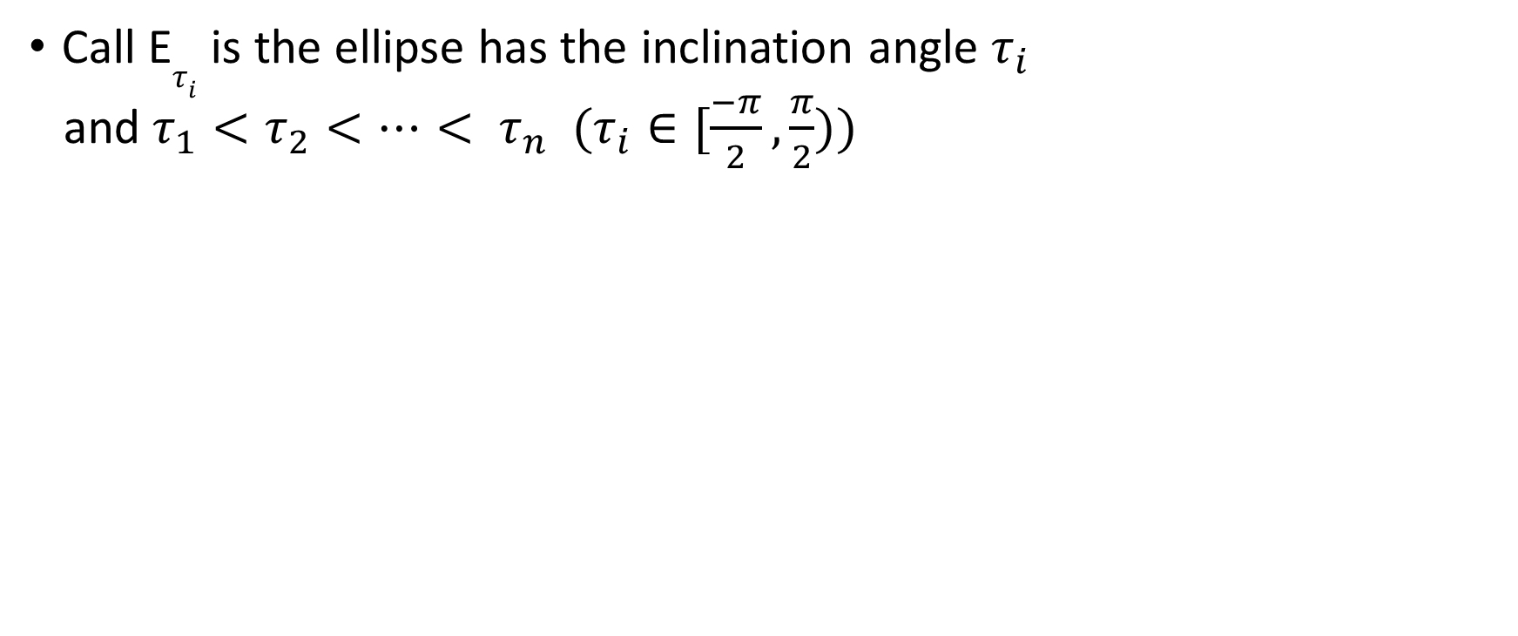
The big picture of the problem
Call E$τ_{i}$ is the ellipse has the inclination angle $τ_{i}$
and $τ_{1}<τ_{2}<…< τ_{n}$ $(τ_{i}∈[\frac{−π}{2},\frac{π}{2}))$

Slide 19
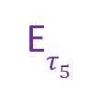
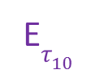
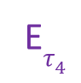
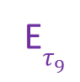
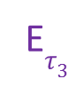
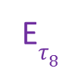
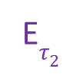
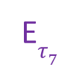
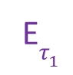

The big picture of the problem
E$τ_{4}$
E$τ_{3}$
E$τ_{5}$
E$τ_{2}$
E$τ_{6}$
E$τ_{1}$
E$τ_{7}$
E$τ_{8}$
. O
E$τ_{9}$
E$τ_{10}$

Slide 20
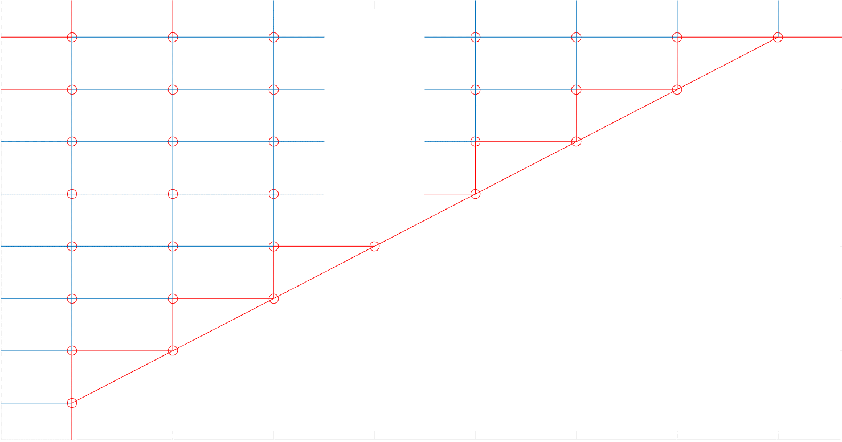
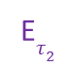
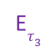
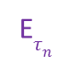
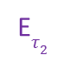
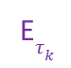
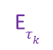
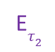
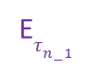
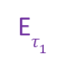



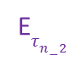
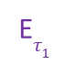
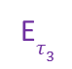
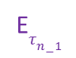

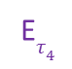
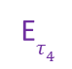
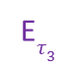

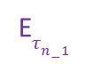






The big picture of the problem
(n-1) vertices at the top
(n-1) vertices at the top
E$τ_{1}$
E$τ_{2}$
E$τ_{3}$
. . .
E$τ_{4}$
E$τ_{n−3}$
E$τ_{n−2}$
E$τ_{n−1}$
E$τ_{1}$
E$τ_{2}$
E$τ_{3}$
. . .
E$τ_{4}$
E$τ_{n−3}$
E$τ_{n−2}$
E$τ_{n−1}$
E$τ_{n}$
. . .
E$τ_{n}$
. . .
E$τ_{n−1}$
. . .
E$τ_{n−1}$
. . .
E$τ_{n−2}$
. . .
E$τ_{n−2}$
. . .
E$τ_{k}$
. . .
E$τ_{k}$
. . .
.
.
.
.
.
.
E$τ_{4}$
E$τ_{4}$
E$τ_{3}$
E$τ_{3}$
E$τ_{2}$
E$τ_{2}$
Left side
Right side

Slide 21


































The big picture of the problem
E$τ_{2}$
E$τ_{3}$
E$τ_{4}$
E$τ_{7}$
E$τ_{n−6}$
E$τ_{n−5}$
E$τ_{n−5}$
E$τ_{n−4}$
E$τ_{n−2}$
E$τ_{1}$
E$τ_{5}$
E$τ_{6}$
E$τ_{8}$
. . .
E$τ_{n−4}$
E$τ_{n−3}$
E$τ_{n−1}$
Another equivalent graph with merged left and right sides
E$τ_{n}$
E$τ_{n−1}$
E$τ_{n−2}$
E$τ_{n−3}$
E$τ_{n−4}$
E$τ_{n−5}$
E$τ_{n−6}$
E$τ_{n−7}$
E$τ_{n−8}$
E$τ_{8}$
E$τ_{7}$
E$τ_{6}$
E$τ_{5}$
E$τ_{4}$
E$τ_{3}$
E$τ_{2}$
E$τ_{1}$
. . .
. . .
. . .
E$τ_{3}$
E$τ_{4}$
E$τ_{5}$
E$τ_{8}$
E$τ_{10}$
E$τ_{n−1}$
E$τ_{2}$
E$τ_{6}$
E$τ_{7}$
E$τ_{9}$
E$τ_{11}$
E$τ_{12}$
E$τ_{13}$
. . .
E$τ_{n−3}$
E$τ_{n−2}$
E$τ_{n}$
. . .

Slide 22

The big picture of the problem
Observation (n is the number of great circles)
On every side, all the vertices have the degree 4
There are $\frac{\left(n−1\right)∗n}{2}$ vertices on every side
Proof: a couple of great circles will create 2 intersections on the Earth, so the total vertices on both side would be $2∗C_{n}^{2}=\left(n−1\right)∗n$. Moreover, the number of vertices is split equally into 2 sides or every side will have $\frac{\left(n−1\right)∗n}{2}$ vertices
There are (n-1)*2+2 = 2n external links on every side to connect to other side.
There are 2 K₃ formed by the external links
There are (n-2) K₃ on both sides
➔ 2*(n-2) + 2 = 2(n-1) K₃ (triangles) where we need 3 different colors for 3 vertices

Slide 23

Chromatic number
deg(V_{i}) = 4
Since a vertex only allows 2 circles to pass through it, so every vertex will have 4 neighbors which means deg(V_{i}) = 4
The graph G is planar
All the vertices are formed by the intersections of the circles. So, there is no sudden arc may cut through the connection between vertices since by contradiction, it will keep forming the vertices continuously and it makes no sense
$3≤χ\left(G\right)≤4$
According to four color theorem, a planar graph only needs 4 colors
A triangle can be formed by 3 random circles which means at that triangle, its vertices needs 3 different colors. Or the graph G contains a sub graph K₃
Prove $χ\left(G\right)=3$ by providing a way to color the graph with 3 colors

Slide 24

Chromatic number
Prove $χ\left(G\right)=3$
I split the problem into 4 sub-problems that have:
3k great circles (3, 6, 9, 12, 15,….) (including (6k+3))
2k great circles (4, 6, 8, 10, 12,…) (including 6k, (6k+2), (6k+4))
(6k+1) great circles (7, 13, 19, 25,…)
(6k+5) great circles (5, 11, 17, 23,…)

Slide 25
Chromatic number
Some rules before coloring
Diagonal rule: The vertices on the same diagonal should have the same color (not a must because there are some places might have K₃ rule)
Proof: The vertices on the same diagonal are not connected together.
K₃ rule: 3 vertices that form a triangle must have 3 different colors

Slide 26
Chromatic number of 3k circles

Slide 27

Chromatic number of 3k circles
Base cases: 3 great circles

Slide 28

Chromatic number of 3k circles
Base cases: 6 great circles

Slide 29

Chromatic number of 3k circles
Base cases: 9 great circles

Slide 30

Chromatic number of 3k circles
Base cases: 12 great circles

Slide 31

Chromatic number of 3k circles
According to the base cases with 3,6,9,12 great circles, the chromatic number is 3
➔Induction hypothesis: $χ\left(G(3K)\right)=3;$($k>0,k∈N)$ that has been correct with k=1,2,3,4 by spreading 3 colors from the bottom left to the top right of the equivalent graph.
➔Induction step: Prove that $χ\left(G(3(K+1))\right)=3$

Slide 32

Chromatic number of 3k circles
The graph G(3(k+1)) contains G(3k) which has been colored already, 3 rows and 3 columns that are not colored yet.

Slide 33

Chromatic number of 3k circles
The uncolored vertices in the diagonals of the graph G(3k) can be colored by the diagonal rule

Slide 34

Chromatic number of 3k circles
4 uncolored vertices on top can be colored by Red-Blue-Green respectively. We can see 3 nodes which link (3k+2) have 3 different colors. The link 3k and (3k+1) are still fine since the colors are generated in a specific order Red-Blue-Green. Everything is still fine

Slide 35

Chromatic number of 3k circles
12 uncolored vertices on the bottom left can be colored by Red-Blue-Green respectively spread from left to right respectively. Specially, 3 vertices whose link (2) have 3 different colors. The vertices which link 3,4,5,6,7 do not conflict others on top

Slide 36

Chromatic number of 3k circles
➔$χ\left(G(3(K+1))\right)=3$
➔ The induction hypothesis is correct
➔ $χ\left(G(3k\right))=3$ $;$($k>0,k∈N)$

Slide 37
Chromatic number of 2k circles

Slide 38


Chromatic number of 2k circles
With the graph 2k, I tried the same way to color the graph but it didn’t work out
8 great circles
10 great circles

Slide 39


Chromatic number of 2k circles
I tried to color it into a different way is to spread 2 colors Blue-Green from the bottom left to the top right of the equivalent graph and then put the color Red into the appropriate vertices.
6 great circles
8 great circles

Slide 40

Chromatic number of 2k circles
Base cases: 10 great circles

Slide 41

Chromatic number of 2k circles
According to the base cases with 4,8,10 great circles, the chromatic number is 3
➔Induction hypothesis: $χ\left(G(2K)\right)=3;$($k>1,k∈N)$ that has been correct with k=2,4,5 by spreading 2 colors Blue-Green from the bottom left to the top right of the equivalent graph and then putting the color Red into the appropriate vertices.
➔Induction step: Prove that $χ\left(G(2(K+1))\right)=3$

Slide 42

Chromatic number of 2k circles
The graph G(2(k+1)) contains G(2k) which has been colored already, …..

Slide 43

Chromatic number of 2k circles
The vertices on the right edge of G(2k) can use 1 color Green since currently they don’t have the K₃ rule

Slide 44

Chromatic number of 2k circles
The vertices on the right and top can be colored by spreading Green-Blue and placing Red as the figure to satisfy the K₃ rule on the right edge

Slide 45

Chromatic number of 2k circles
Continue to color others by the same way. The vertices which link (3,4,5,…2k) on top don’t conflict those on bottom. All the K₃ are also satisfied

Slide 46

Chromatic number of 2k circles
➔$χ\left(G(2(K+1))\right)=3$
➔ The induction hypothesis is correct
➔ $χ\left(G(2k\right))=3$ $;$($k>1,k∈N)$

Slide 47
Chromatic number of (6k+1) circles

Slide 48



Chromatic number of (6k+1) circles
This type of graph doesn’t suit 2 previous coloring ways because:
3k: There is always a K₃ (2) that contains 2 vertices have the same color because $\left(6k+1\right)≡1\left(mod 3\right)$
2k: $\left(6k+1\right)≡1\left(mod 2\right)$, so K₃ (contains link 2) always has 2 vertices have the same color
Color the graph by the way used on 3k graphs
Color the graph by the way used on 2k graphs

Slide 49

Chromatic number of (6k+1) circles
By modifying the technique of 3k graphs a little bit, I can color the graph with 7 great circles. We can see the difference in between 2 black slashes

Slide 50

Chromatic number of (6k+1) circles
Greedily continue to color the graph with 13 great circles, we can see that outside of the slashes, the colors are similar to the 1st technique used for 3k graphs

Slide 51

Chromatic number of (6k+1) circles
Another base case with 19 great circles

Slide 52

Chromatic number of (6k+1) circles
With k>2, by spreading RED-BLUE-GREEN respectively on the additional diagonals, I can color all this type of graph based on the case k=2
The vertex on the top right is always left because
step $6k≡0\left(mod3\right)$
The other additional vertices use spreading
technique which doesn’t create conflicts on
the links at edges
Similar to the coloring way of 3k graphs,
all additional K₃ are also satisfied
This vertex is always red

Slide 53
Chromatic number of (6k+5) circles

Slide 54

Chromatic number of (6k+5) circles
Base cases: 5 great circles

Slide 55

Chromatic number of (6k+5) circles
Base cases: 11 great circles

Slide 56

Chromatic number of (6k+5) circles
Base cases: 17 great circles

Slide 57
Chromatic number of (6k+5) circles
This type of graph is similar to (6k+1) graph. With cases k>1, by spreading RED-BLUE-GREEN respectively on the diagonals, I can color all this type of graph based on the case k=1

Slide 58

Chromatic number of (6k+5) circles
According to the techniques to color the graphs including 3k, 2k, 6k+1 and 6k+5 great circles, there are only 3 colors used
➔ $χ\left(G\right)=3$

Slide 59


Slide 60

Only takes 0.12s to find colors in this graph on my laptop

Slide 61
5. Algorithms used in the visualization

Slide 62

Visualization
The problem is visualized on MATLAB. All the great circles are generated randomly.
I have used the library geom3d, written by David Legland, to draw the problem in 3-D view
The outcome of the application
Draw the problem in 3D
Adjacency Matrix
Edges matrix
Matrix_Circles, Matrix_Vertices (which are defined in the next 4 slide)
Points what forms a single circle (2000)
And properties of all circles (THETA $θ,\text{PHI} φ$)

Slide 63

Creating great circles
drawCircle3d([C_{x} C_{y} C_{z} R THETA PHI])
Description:
Spherical coordinates
C_{x} C_{y} C_{z} are coordinates of circle center
R is the circle radius
THETA $θ$between 0 and 180 degrees, corresponding to the azimuth angle
PHI $φ$ between 0 and 360 degrees, corresponding to the zenith angle
References: Parametric Equation of a Circle in 3D,
Spherical Coordinates

Slide 64

Creating great circles
$$P\left(t\right)=rcos\left(t\right)u+rsin\left(t\right)n×u+C$$
$n=\left[\begin{matrix}sinθcosφ \\ sinθsinφ \\ cosθ\end{matrix}\right]$; $u=\left[\begin{matrix}−sinφ \\ cosφ \\ 0\end{matrix}\right]$; $n×u=\left[\begin{matrix}cosθcosφ \\ cosθsinφ \\ −sinθ\end{matrix}\right]$
➔$\left[\begin{matrix}x \\ y \\ z\end{matrix}\right]=\left[\begin{matrix}−sinφ\cos\left(t\right)+cosθcosφsin⁡(t) \\ cosφ\cos\left(t\right)+cosθsinφsin⁡(t) \\ −sinθsin⁡(t)\end{matrix}\right]$

Slide 65

Creating great circles - Algorithm
Input: parameters ([XC YC ZC R THETA PHI])
Output: a great circle
Pseudocode:
Create k linearly spaced points in the interval (0, $2π)$
Calculate the points coordinates:
x = r(i) * cos(t);
y = r(i) * sin(t);
z = 0;
circle0 = [x y z];
Compute transformation from local basis to world basis
trans = localToGlobal3d(xc(i), yc(i), zc(i), theta(i), phi(i), psi(i)); // psi = 0;
Compute points of transformed circle
circle = transformPoint3d(circle0, trans);

Slide 66
Detecting intersections
Input: a pair of great circles [XC YC ZC R THETA PHI]
Output: 2 intersection coordinates (X,Y,Z)
Pseudocode:
Find the planes containing each great circles
Find the line intersected by the 2 planes
Output 2 intersection points made by the line and a circle

Slide 67
Matrix_Circles, Matrix_Vertices
Matrix_Circles: a 3-dimensional-array contains lists of what vertices are in each great circle
Matrix_Vertices: a 2-dimensional-array contains adjacency nodes of each vertex

Slide 68
Finding edges
Input: a list in Matrix_Circles in term of vertices on a great circle
Output: Edges
Pseudocode:
Easily figure out the order of vertices on the circle by the formula to generate them
Each vertex will have an edge to 2 its adjacency nodes
1st
.
10th
.
20th
.

Slide 69
Thank you

